Slide 1

Return Rate Researchers
Rebecca Melo, Ngoc-Tran Nguyen, Hinley Fung and Stephanie Thurstone

Slide 2
Table of Contents
01
Motivation & Summary
02
Technology Stack
03
Demo - Read our Story
04
Discussion
05
Post Mortem

Slide 3
Motivation & Summary
Have you ever wanted to know where to find the best of everything in one specific location while traveling or where to travel to in search of ‘the best’? Avid travelers visit this interactive dashboard in an effort to narrow down the areas in which they wish to travel based on visualizations and click-through data that provides in depth information based on the area of interest. Users frequent this app to decide where they will travel next.

Slide 4
Technology Stack
Python
Pandas
PostgresSQL
HTML, Bootstrap and CSS formatting
API
JavaScript
Moment.js
jQuery
ZURB Foundation
Leaflet
Notes:
Here you will see a list of utilized technology

Slide 5


Data Collection
API: Google Maps API, Traveladvisor API & OpenWeather API
ETL:
Extracting: Hotel datasets from kaggle
Transforming: Combine the dataset and remove unneeded information keeping Hotel information making the information easy to read.
Load : Loading the data into Postgres Database

Slide 6
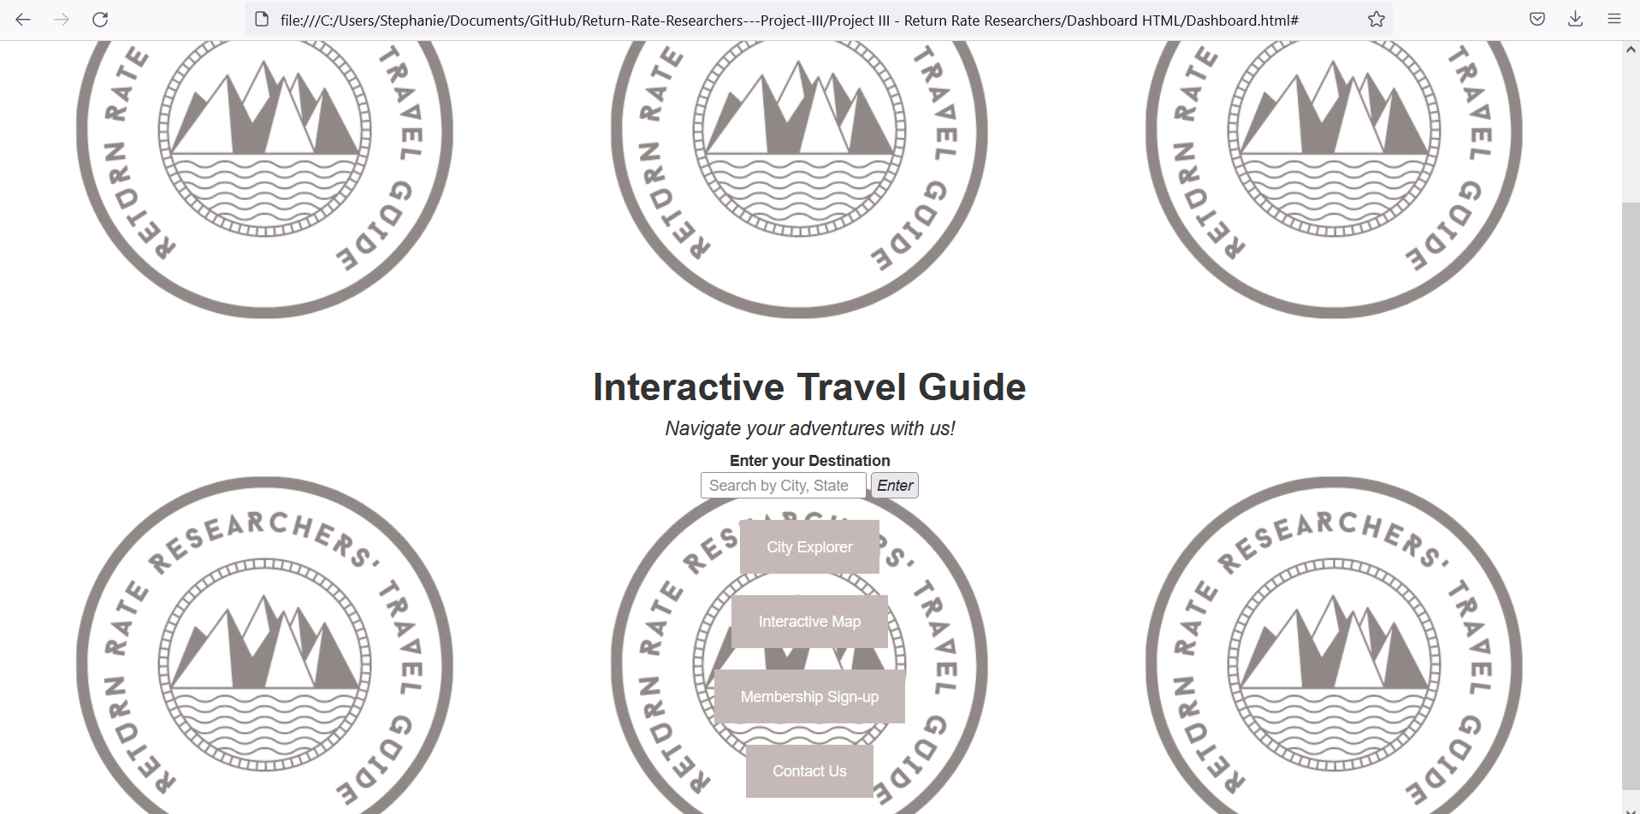
Navigate your adventures to ‘the best’ with us!
Welcome to our Dashboard Home Page where you can navigate the site through an interactive search that leads you directly to our City Explorer page or by clicking one of the various links which will then direct you to additional pages within our site that will aid in easy travels!

Slide 7
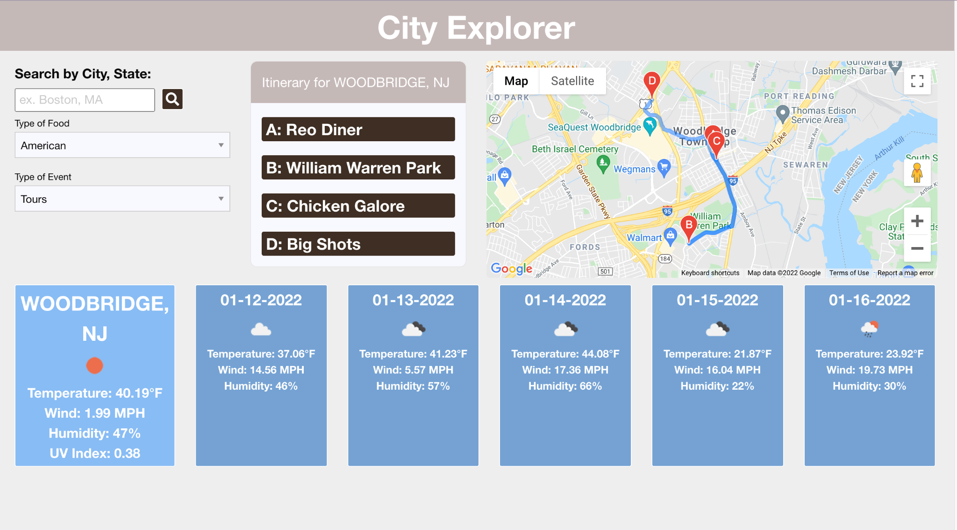
City Explorer
Using Tripadvisor API, Google Maps API and OpenWeather API, this interactive dashboard will get you an itinerary for restaurants and events a person is interested in based on the City and State you search.
Food and restaurant type can be filtered to your preference and each point will be mapped on Google maps to know where your day will take you! In addition, a weather dashboard is shown as well so you can prepare your outfit for the day.

Slide 8
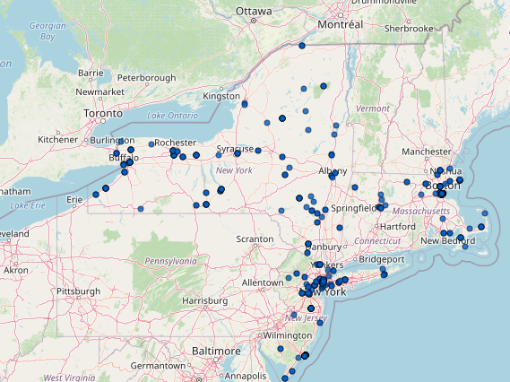
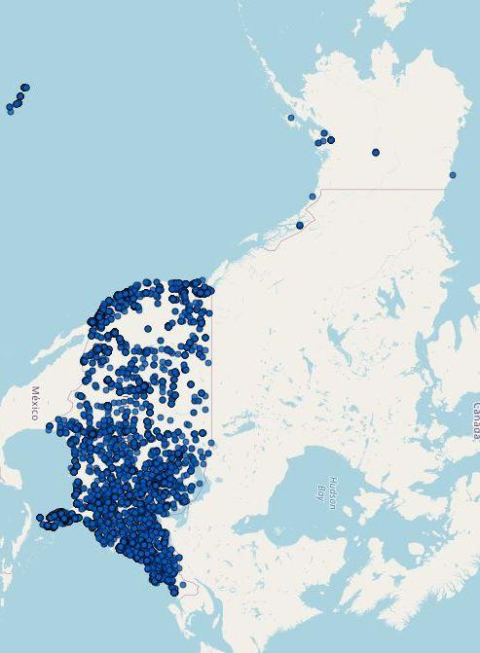
Interactive Map
Using the hotel dataset information we are able to plot them onto an interactive map.
From the map you are able to find the hotel address ratings, and direct website for easy booking.

Slide 9
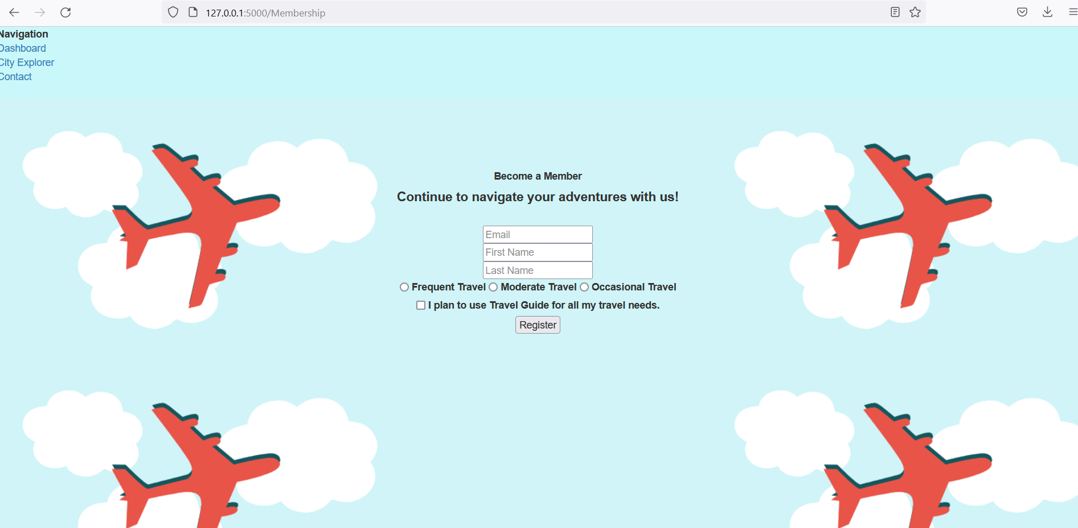
Membership Sign-up
Impressed? Become a member and utilize our platform for free anytime, anywhere!

Slide 10

If you need us, we’ll be there!
Meet your team of Application Experts on our ‘Contact Us’ page.

Slide 11
What Worked vs Not & Next Steps
Learning a new library takes time
Time constraints - in particular to styling
Too much data causes the map to run slow so we needed cut down the data just to a few states.

Slide 12
Our Story
Steph, Tran, Hinley and Rebecca are planning a trip to visit
their favorite instructor & TA, Ashish and Hector, in New Jersey but they know nothing about the area! Having a nice, clean hotel is really important to Steph, great food is Hinley’s kryptonite (he wants to try all of the best spots in the area), Tran wants to see the sites and Rebecca wants to know where she can find the best Sushi. If only we had one site that would tell us the best of all of these in one and also provide us with a direct route……
Oh, wait…we do.
Welcome to Travel Guide, an interactive app to help
you find the best of the best anywhere, anytime.

Slide 13
Let’s take a trip to New Jersey…..
Notes:
Begin demo of site

Slide 14
Questions?

